Slide 1
MODULAR PROGRAMMING
BHAVANA
DAY 15
23/04/2024

Slide 2
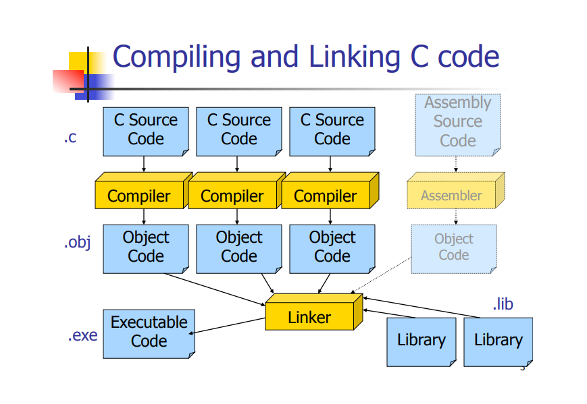

Slide 3
Object code module :
It contains binary code corrsponding to a source C module
It contains external references to functions and variables declared in other modules
It contains functions and variables used by other modules
Only one module contains function main().

Slide 4
Private functions:
The keyword static is used to specify which functions must not be public, so they are just usable within the module.
void InsertionSort(int A[], int n) ;
void DeleteVector(int A[], int n) ;
void InsertionSort(int A[], int n) { . . . }
static void DeleteVector(int A[], int n) { . . . }

Slide 5
Global Variables
A global variable in a module is visible by all the other modules by default.
Module using an external variable must declare its prototype (with keyword extern)
The keyword static is used to specify which variables must not be public, so they are just visible within the module.
Local variables (within functions) cannot be shared.

Slide 6


